Slide 1
Unit-V

Slide 2
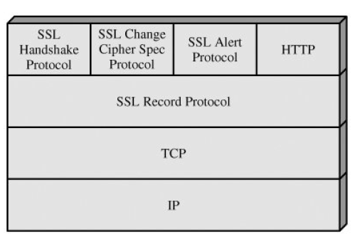
Secure Socket Layer
SSL is designed to make use of TCP to provide a reliable end-to-end secure service.
SSL is not a single protocol but rather two layers of protocols

Slide 3
SSL Architecture
The SSL Record Protocol provides basic security services to various higher-layer protocols.
The Hypertext Transfer Protocol (HTTP), which provides the transfer service for Web client/server interaction, can operate on top of SSL.
Three higher-layer protocols are defined as part of SSL:
the Handshake Protocol,
the Change Cipher Spec Protocol, and
the Alert Protocol.
These SSL-specific protocols are used in the management of SSL exchanges

Slide 4
SSL concepts
Connection:
A connection is a transport (in the OSI layering model definition) that provides a suitable type of service.
For SSL, such connections are peer-to-peer relationships.
The connections are transient.
Every connection is associated with one session.
Session:
An SSL session is an association between a client and a server.
Sessions are created by the Handshake Protocol.
Sessions define a set of cryptographic security parameters, which can be shared among multiple connections.
Sessions are used to avoid the expensive negotiation of new security parameters for each connection.

Slide 5
Session State parameters
Session identifier: An arbitrary byte sequence chosen by the server to identify an active or resumable session state.
Peer certificate: An X509.v3 certificate of the peer. This element of the state may be null.
Compression method: The algorithm used to compress data prior to encryption.
Cipher spec: Specifies the bulk data encryption algorithm (such as null, AES, etc.) and a hash algorithm (such as MD5 or SHA-1) used for MAC calculation. It also defines cryptographic attributes such as the hash_size.
Master secret: 48-byte secret shared between the client and server.
Is resumable: A flag indicating whether the session can be used to initiate new connections.

Slide 6
Connection State parameters
Server and client random: Byte sequences that are chosen by the server and client for each connection.
Server write MAC secret: The secret key used in MAC operations on data sent by the server.
Client write MAC secret: The secret key used in MAC operations on data sent by the client.
Server write key: The conventional encryption key for data encrypted by the server and decrypted by the client.
Client write key: The conventional encryption key for data encrypted by the client and decrypted by the server.
Initialization vectors: When a block cipher in CBC mode is used, an initialization vector (IV) is maintained for each key. This field is first initialized by the SSL Handshake Protocol. Thereafter the final ciphertext block from each record is preserved for use as the IV with the following record.
Sequence numbers: Each party maintains separate sequence numbers for transmitted and received messages for each connection. When a party sends or receives a change cipher spec message, the appropriate sequence number is set to zero. Sequence numbers may not exceed 264 1.

Slide 7
SSL Record Protocol
The SSL Record Protocol provides two services for SSL connections:
Confidentiality: The Handshake Protocol defines a shared secret key that is used for conventional encryption of SSL payloads.
Message Integrity: The Handshake Protocol also defines a shared secret key that is used to form a message authentication code (MAC).

Slide 8
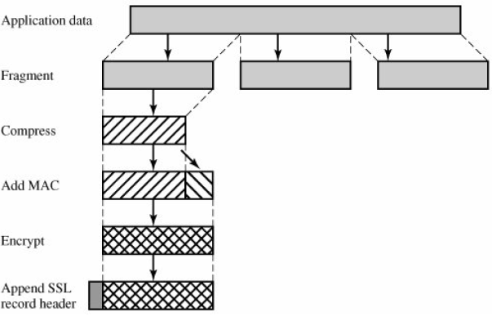
SSL Record Protocol Operation

Slide 9
SSL Record header
SSL Record Protocol processing is to prepend a header, consisting of the following fields:
Content Type (8 bits): The higher layer protocol used to process the enclosed fragment.
Major Version (8 bits): Indicates major version of SSL in use. For SSLv3, the value is 3.
Minor Version (8 bits): Indicates minor version in use. For SSLv3, the value is 0.
Compressed Length (16 bits): The length in bytes of the plaintext fragment (or compressed fragment if compression is used). The maximum value is 2¹⁴ + 2048.

Slide 10
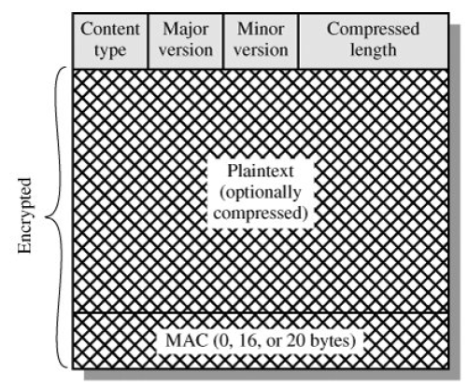
SSL Record Format

Slide 11
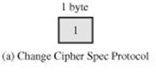
Change Cipher Spec Protocol
This protocol consists of a single message, which consists of a single byte with the value 1.
The sole purpose of this message is to cause the pending state to be copied into the current state, which updates the cipher suite to be used on this connection.

Slide 12

Alert Protocol
Each message in this protocol consists of two bytes
The first byte takes the value warning(1) or fatal(2) to convey the severity of the message.
If the level is fatal, SSL immediately terminates the connection. Other connections on the same session may continue, but no new connections on this session may be established.
The second byte contains a code that indicates the specific alert.

Slide 13
Alert Protocol (Alerts)
unexpected_message: An inappropriate message was received.
bad_record_mac: An incorrect MAC was received.
decompression_failure: The decompression function received improper input (e.g., unable todecompress or decompress to greater than maximum allowable length).
handshake_failure: Sender was unable to negotiate an acceptable set of security parameters
given the options available.
illegal_parameter: A field in a handshake message was out of range or inconsistent with other fields.
close_notify: Notifies the recipient that the sender will not send any more messages on this connection. Each party is required to send a close_notify alert before closing the write side of a connection.
no_certificate: May be sent in response to a certificate request if no appropriate certificate is available.
bad_certificate: A received certificate was corrupt (e.g., contained a signature that did not verify).
unsupported_certificate: The type of the received certificate is not supported.
certificate_revoked: A certificate has been revoked by its signer.
certificate_expired: A certificate has expired.
certificate_unknown: Some other unspecified issue arose in processing the certificate, rendering it unacceptable.

Slide 14

Handshake Protocol
This protocol allows the server and client to authenticate each other and to negotiate an encryption and MAC algorithm and cryptographic keys to be used to protect data sent in an SSL record.
Each message has three fields:
Type (1 byte): Indicates one of 10 messages.
Length (3 bytes): The length of the message in bytes.
Content ( 0 bytes): The parameters associated with this message;

Slide 15
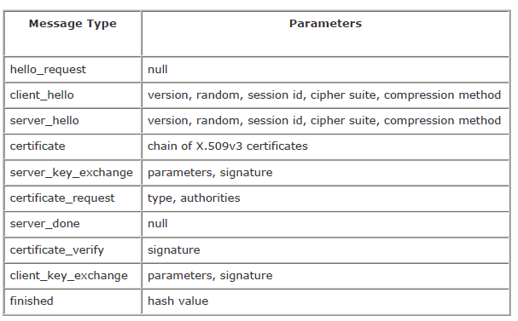
SSL Handshake Protocol Message Types

Slide 16
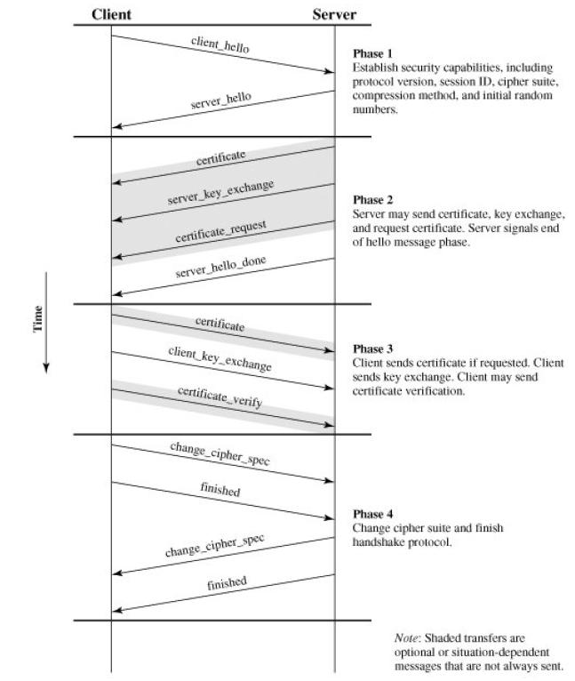
Handshake Protocol Action

Slide 17

HTTP Protocol

Slide 18
Transport Layer Security
TLS is an IETF standardization initiative whose goal is to produce an Internet standard version of SSL.
Differences
1. Version Number
The TLS Record Format is the same as that of the SSL Record Format (Figure 17.4), and the fields in the header have the same meanings.
The one difference is in version values. For the current version of TLS, the Major Version is 3 and the Minor Version is 1.

Slide 19
Transport Layer Security (Contd…)
2. Message Authentication Code
There are two differences between the SSLv3 and TLS MAC schemes: the actual algorithm and the scope of the MAC calculation.
TLS makes use of the HMAC algorithm
SSLv3 uses the same algorithm, except that the padding bytes are concatenated with the secret key rather than being XORed with the secret key padded to the block length.
The level of security should be about the same in both cases.
The MAC calculation covers all of the fields covered by the SSLv3 calculation, plus the field TLSCompressed.version, which is the version of the protocol being employed.

Slide 20
Transport Layer Security (Contd…)
3. Pseudorandom Function
TLS makes use of a pseudorandom function referred to as PRF to expand secrets into blocks of data for purposes of key generation or validation.
4. Alert Codes
TLS supports all of the alert codes defined in SSLv3 with the exception of no_certificate. A number of additional codes are defined in TLS; of these, the following are always fatal:
decryption_failed: A ciphertext decrypted in an invalid way; either it was not an even multiple of the block length or its padding values, when checked, were incorrect.
record_overflow: A TLS record was received with a payload (ciphertext) whose length exceeds 214 + 2048 bytes, or the ciphertext decrypted to a length of greater than 214 + 1024 bytes.
unknown_ca: A valid certificate chain or partial chain was received, but the certificate was not accepted because the CA certificate could not be located or could not be matched with a known, trusted CA.
access_denied: A valid certificate was received, but when access control was applied, the sender decided not to proceed with the negotiation.

Slide 21
Transport Layer Security (Contd…)
decode_error: A message could not be decoded because a field was out of its specified range or the length of the message was incorrect.
export_restriction: A negotiation not in compliance with export restrictions on key length was detected.
protocol_version: The protocol version the client attempted to negotiate is recognized but not supported.
insufficient_security: Returned instead of handshake_failure when a negotiation has failed specifically because the server requires ciphers more secure than those supported by the client.
internal_error: An internal error unrelated to the peer or the correctness of the protocol makes it impossible to continue.
The remainder of the new alerts include the following:
decrypt_error: A handshake cryptographic operation failed, including being unable to verify a signature, decrypt a key exchange, or validate a finished message.
user_canceled: This handshake is being canceled for some reason unrelated to a protocol failure.
no_renegotiation: Sent by a client in response to a hello request or by the server in response to a client hello after initial handshaking. Either of these messages would normally result in renegotiation, but this alert indicates that the sender is not able to renegotiate. This message is always a warning.

Slide 22
Transport Layer Security (Contd…)
5. Cipher Suites
There are several small differences between the cipher suites available under SSLv3 and under TLS:
Key Exchange: TLS supports all of the key exchange techniques of SSLv3 with the exception of Fortezza.
Symmetric Encryption Algorithms: TLS includes all of the symmetric encryption algorithms found in SSLv3, with the exception of Fortezza.
6. Certificate_Verify and Finished Messages
In the TLS certificate_verify message, the MD5 and SHA-1 hashes are calculated only over handshake_messages.
For SSLv3, the hash calculation also included the master secret and pads.
These extra fields were felt to add no additional security.
As with the finished message in SSLv3, the finished message in TLS is a hash based on the shared master_secret, the previous handshake messages, and a label that identifies client or server.
The calculation is somewhat different.

Slide 23
Transport Layer Security (Contd…)
7. Padding
In SSL, the padding added prior to encryption of user data is the minimum amount required so that the total size of the data to be encrypted is a multiple of the cipher's block length.
In TLS, the padding can be any amount that results in a total that is a multiple of the cipher's block length, up to a maximum of 255 bytes.

Slide 24
Secure Electronic Transaction
SET is an open encryption and security specification designed to protect credit card transactions on the Internet.
SET is not itself a payment system. Rather it is a set of security protocols and formats that enables users to employ the existing credit card payment infrastructure on an open network, such as the Internet, in a secure fashion.
SET provides three services:
Provides a secure communications channel among all parties involved in a transaction
Provides trust by the use of X.509v3 digital certificates
Ensures privacy because the information is only available to parties in a transaction when and where necessary

Slide 25
Secure Electronic Transaction (Contd…)
Requirements
Provide confidentiality of payment and ordering information
Ensure the integrity of all transmitted data
Provide authentication that a cardholder is a legitimate user of a credit card account
Provide authentication that a merchant can accept credit card transactions through its relationship with a financial institution
Ensure the use of the best security practices and system design techniques to protect all legitimate parties in an electronic commerce transaction
Create a protocol that neither depends on transport security mechanisms nor prevents their use
Facilitate and encourage interoperability among software and network providers

Slide 26
Secure Electronic Transaction (Contd…)
Key Features of SET
To meet the requirements just outlined, SET incorporates the following features:
1. Confidentiality of information:
Cardholder account and payment information is secured as it travels across the network.
An interesting and important feature of SET is that it prevents the merchant from learning the cardholder's credit card number; this is only provided to the issuing bank.
Conventional encryption by DES is used to provide confidentiality.
2. Integrity of data:
Payment information sent from cardholders to merchants includes order information, personal data, and payment instructions. SET guarantees that these message contents are not altered in transit.
RSA digital signatures, using SHA-1 hash codes, provide message integrity. Certain messages are also protected by HMAC using SHA-1.

Slide 27
Secure Electronic Transaction (Contd…)
3. Cardholder account authentication:
SET enables merchants to verify that a cardholder is a legitimate user of a valid card account number. SET uses X.509v3 digital certificates with RSA signatures for this purpose.
4. Merchant authentication:
SET enables cardholders to verify that a merchant has a relationship with a financial institution allowing it to accept payment cards. SET uses X.509v3 digital certificates with RSA signatures for this purpose.

Slide 28
Secure Electronic Transaction (Contd…)
SET Participants
1. Cardholder:
In the electronic environment, consumers and corporate purchasers interact with merchants from personal computers over the Internet.
A cardholder is an authorized holder of a payment card (e.g., MasterCard, Visa) that has been issued by an issuer.
2. Merchant:
A merchant is a person or organization that has goods or services to sell to the cardholder.
Typically, these goods and services are offered via a Web site or by electronic mail.
A merchant that accepts payment cards must have a relationship with an acquirer.

Slide 29
Secure Electronic Transaction (Contd…)
3. Issuer:
This is a financial institution, such as a bank, that provides the cardholder with the payment card.
Typically, accounts are applied for and opened by mail or in person.
Ultimately, it is the issuer that is responsible for the payment of the debt of the cardholder.
4. Acquirer:
This is a financial institution that establishes an account with a merchant and processes payment card authorizations and payments.
Merchants will usually accept more than one credit card brand but do not want to deal with multiple bankcard associations or with multiple individual issuers.
The acquirer provides authorization to the merchant that a given card account is active and that the proposed purchase does not exceed the credit limit.
The acquirer also provides electronic transfer of payments to the merchant's account.
Subsequently, the acquirer is reimbursed by the issuer over some sort of payment network for electronic funds transfer.

Slide 30
Secure Electronic Transaction (Contd…)
6. Payment gateway:
This is a function operated by the acquirer or a designated third party that processes merchant payment messages.
The payment gateway interfaces between SET and the existing bankcard payment networks for authorization and payment functions.
The merchant exchanges SET messages with the payment gateway over the Internet, while the payment gateway has some direct or network connection to the acquirer's financial processing system.
7. Certification authority (CA):
This is an entity that is trusted to issue X.509v3 public-key certificates for cardholders, merchants, and payment gateways.
The success of SET will depend on the existence of a CA infrastructure available for this purpose.
A hierarchy of CAs is used, so that participants need not be directly certified by a root authority.

Slide 31
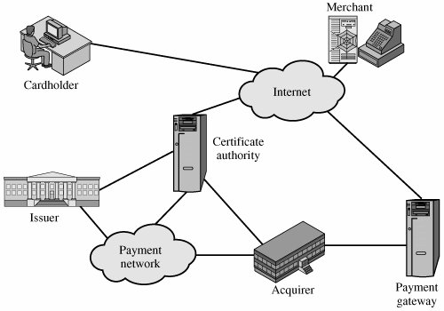
Secure Electronic Transaction (Contd…)

Slide 32
Secure Electronic Transaction (Contd…)
Sequence of events that are required for a transaction
The customer opens an account.
The customer obtains a credit card account, such as MasterCard or Visa, with a bank that supports electronic payment and SET.
The customer receives a certificate.
After suitable verification of identity, the customer receives an X.509v3 digital certificate, which is signed by the bank.
The certificate verifies the customer's RSA public key and its expiration date. It also establishes a relationship, guaranteed by the bank, between the customer's key pair and his or her credit card.
Merchants have their own certificates.
A merchant who accepts a certain brand of card must be in possession of two certificates for two public keys owned by the merchant: one for signing messages, and one for key exchange.
The merchant also needs a copy of the payment gateway's public- key certificate.

Slide 33
Secure Electronic Transaction (Contd…)
The customer places an order.
This is a process that may involve the customer first browsing through the merchant's Web site to select items and determine the price.
The customer then sends a list of the items to be purchased to the merchant, who returns an order form containing the list of items, their price, a total price, and an order number.
The merchant is verified.
In addition to the order form, the merchant sends a copy of its certificate, so that the customer can verify that he or she is dealing with a valid store.
The order and payment are sent.
The customer sends both order and payment information to the merchant, along with the customer's certificate.
The order confirms the purchase of the items in the order form. The payment contains credit card details.
The payment information is encrypted in such a way that it cannot be read by the merchant. The customer's certificate enables the merchant to verify the customer.

Slide 34
Secure Electronic Transaction (Contd…)
The merchant requests payment authorization.
The merchant sends the payment information to the payment gateway, requesting authorization that the customer's available credit is sufficient for this purchase.
The merchant confirms the order.
The merchant sends confirmation of the order to the customer.
The merchant provides the goods or service.
The merchant ships the goods or provides the service to the customer.
The merchant requests payment.
This request is sent to the payment gateway, which handles all of the payment processing.

Slide 35
Secure Electronic Transaction (Contd…)
SET Transaction Types
1 | Cardholder registration | Cardholders must register with a CA before they can send SET messages to merchants.
2 | Merchant registration | Merchants must register with a CA before they can exchange SET messages with customers and payment gateways.
3 | Purchase request | Message from customer to merchant containing OI for merchant and PI for bank.
4 | Payment authorization | Exchange between merchant and payment gateway to authorize a given amount for a purchase on a given credit card account.
5 | Payment capture | Allows the merchant to request payment from the payment gateway.
6 | Certificate inquiry and status | If the CA is unable to complete the processing of a certificate request quickly, it will send a reply to the cardholder or merchant indicating that the requester should check back later. The cardholder or merchant sends the Certificate Inquiry message to determine the status of the certificate request and to receive the certificate if the request has been approved.

Slide 36
Secure Electronic Transaction (Contd…)
SET Transaction Types
7 | Purchase inquiry | Allows the cardholder to check the status of the processing of an order after the purchase response has been received. Note that this message does not include information such as the status of back ordered goods, but does indicate the status of authorization, capture and credit processing.
8 | Authorization reversal | Allows a merchant to correct previous authorization requests. If the order will not be completed, the merchant reverses the entire authorization. If part of the order will not be completed (such as when goods are back ordered), the merchant reverses part of the amount of the authorization.
9 | Capture reversal | Allows a merchant to correct errors in capture requests such as transaction amounts that were entered incorrectly by a clerk.
10 | Credit reversal | Allows a merchant to correct a previously request credit.

Slide 37
Secure Electronic Transaction (Contd…)
SET Transaction Types
11 | Credit | Allows a merchant to issue a credit to a cardholder's account such as when goods are returned or were damaged during shipping. Note that the SET Credit message is always initiated by the merchant, not the cardholder. All communications between the cardholder and merchant that result in a credit being processed happen outside of SET.
12 | Payment gateway certificate request | Allows a merchant to query the payment gateway and receive a copy of the gateway's current key-exchange and signature certificates.
13 | Batch administration | Allows a merchant to communicate information to the payment gateway regarding merchant batches.
14 | Error message | Indicates that a responder rejects a message because it fails format or content verification tests.

Slide 38
Intruders
One of the two most publicized threats to security is the intruder (the other is viruses), generally referred to as a hacker or cracker.
Three classes of intruders:
Masquerader: An individual who is not authorized to use the computer and who penetrates a system's access controls to exploit a legitimate user's account
Misfeasor: A legitimate user who accesses data, programs, or resources for which such access is not authorized, or who is authorized for such access but misuses his or her privileges
Clandestine user: An individual who seizes supervisory control of the system and uses this control to evade auditing and access controls or to suppress audit collection
The masquerader is likely to be an outsider; the misfeasor generally is an insider; and the clandestine user can be either an outsider or an insider.

Slide 39
Intrusion Detection
Intrusion detection is based on the assumption that the behavior of the intruder differs from that of a legitimate user in ways that can be quantified.

Slide 40
Approaches to intrusion detection
1. Statistical anomaly detection
Involves the collection of data relating to the behavior of legitimate users over a period of time.
Then statistical tests are applied to observed behavior to determine with a high level of confidence whether that behavior is not legitimate user behavior.
Threshold detection: This approach involves defining thresholds, independent of user, for the frequency of occurrence of various events.
Profile based: A profile of the activity of each user is developed and used to detect changes in the behavior of individual accounts.

Slide 41
Approaches to intrusion detection
2. Rule-based detection
Involves an attempt to define a set of rules that can be used to decide that a given behavior is that of an intruder.
Anomaly detection: Rules are developed to detect deviation from previous usage patterns.
Penetration identification: An expert system approach that searches for suspicious behavior.

Slide 42
Audit Records
A fundamental tool for intrusion detection is the audit record. Some record of ongoing activity by users must be maintained as input to an intrusion detection system.
Basically, two plans are used:
Native audit records:
Virtually all multiuser operating systems include accounting software that collects information on user activity.
The advantage of using this information is that no additional collection software is needed.
The disadvantage is that the native audit records may not contain the needed information or may not contain it in a convenient form.
Detection-specific audit records:
A collection facility can be implemented that generates audit records containing only that information required by the intrusion detection system.
One advantage of such an approach is that it could be made vendor independent and ported to a variety of systems.
The disadvantage is the extra overhead involved in having, in effect, two accounting packages running on a machine.

Slide 43
Audit Record Fields
Subject:
Initiators of actions.
A subject is typically a terminal user but might also be a process acting on behalf of users or groups of users.
Action:
Operation performed by the subject on or with an object; for example, login, read, perform I/O, execute.
Object:
Receptors of actions. Examples include files, programs, messages, records, terminals, printers, and user- or program-created structures.
Exception-Condition:
Denotes which, if any, exception condition is raised on return.
Resource-Usage:
A list of quantitative elements in which each element gives the amount used of some resource (number of records read or written, processor time)
Time-Stamp:
Unique time-and-date stamp identifying when the action took place.

Slide 44
Statistical Anomaly Detection
Statistical anomaly detection techniques fall into two broad categories:
Threshold detection and
profile-based systems
Threshold detection involves counting the number of occurrences of a specific event type over an interval of time. If the count surpasses what is considered a reasonable number that one might expect to occur, then intrusion is assumed.
Threshold analysis, by itself, is a crude and ineffective detector of even moderately sophisticated attacks.
Both the threshold and the time interval must be determined.
Because of the variability across users, such thresholds are likely to generate either a lot of false positives or a lot of false negatives.
However, simple threshold detectors may be useful in conjunction with more sophisticated techniques.

Slide 45
Statistical Anomaly Detection
Profile-based anomaly detection focuses on characterizing the past behavior of individual users or related groups of users and then detecting significant deviations.
A profile may consist of a set of parameters, so that deviation on just a single parameter may not be sufficient in itself to signal an alert.

Slide 46
Statistical Anomaly Detection
The foundation of this approach is an analysis of audit records.
The audit records provide input to the intrusion detection function in two ways.
First, the designer must decide on a number of quantitative metrics that can be used to measure user behavior.
An analysis of audit records over a period of time can be used to determine the activity profile of the average user.
Second, current audit records are the input used to detect intrusion.
That is, the intrusion detection model analyzes incoming audit records to determine deviation from average behavior.

Slide 47
Statistical Anomaly Detection
Metrics that are useful for profile-based intrusion detection
Counter:
A nonnegative integer, typically, a count of certain event types is kept over a particular period of time.
Examples include the number of logins by a single user during an hour,
Gauge:
A nonnegative integer, typically, used to measure the current value of some entity.
Examples include the number of logical connections assigned to a user application and the number of outgoing messages queued for a user process.
Interval timer:
The length of time between two related events.
An example is the length of time between successive logins to an account.
Resource utilization:
Quantity of resources consumed during a specified period.
Examples include the number of pages printed during a user session and total time consumed by a program execution.

Slide 48
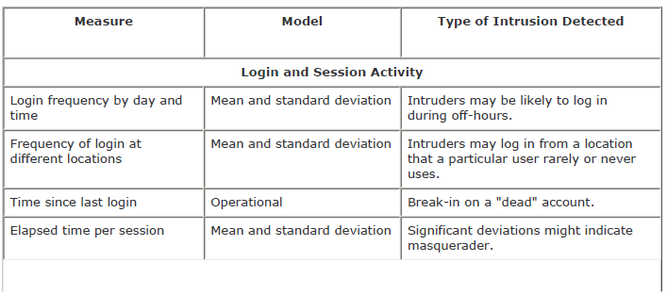
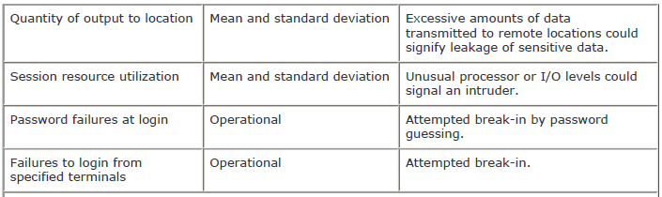
Statistical Anomaly Detection
Measures That May Be Used for Intrusion Detection

Slide 49
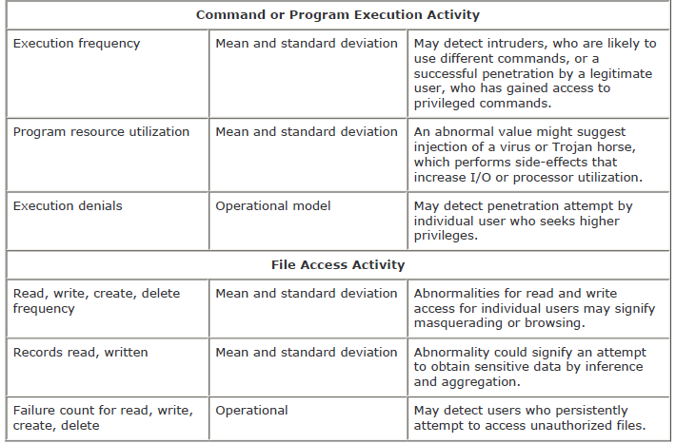
Statistical Anomaly Detection
Measures That May Be Used for Intrusion Detection

Slide 50
Rule-Based Intrusion Detection
Rule-based techniques detect intrusion by observing events in the system and applying a set of rules that lead to a decision regarding whether a given pattern of activity is or is not suspicious.
With the rule-based approach, historical audit records are analyzed to identify usage patterns and to generate automatically rules that describe those patterns.
Rules may represent past behavior patterns of users, programs, privileges, time slots, terminals, and so on.
Current behavior is then observed, and each transaction is matched against the set of rules to determine if it conforms to any historically observed pattern of behavior.

Slide 51
Password Management
Password Protection
The front line of defense against intruders is the password system. Virtually all multiuser systems require that a user provide not only a name or identifier (ID) but also a password. The password serves to authenticate the ID of the individual logging on to the system.
In turn, the ID provides security in the following ways:
The ID determines whether the user is authorized to gain access to a system.
The ID determines the privileges accorded to the user. A few users may have supervisory or "superuser" status that enables them to read files and perform functions that are especially protected by the operating system.
The ID is used in what is referred to as discretionary access control. For example, by listing the IDs of the other users, a user may grant permission to them to read files owned by that user.

Slide 52
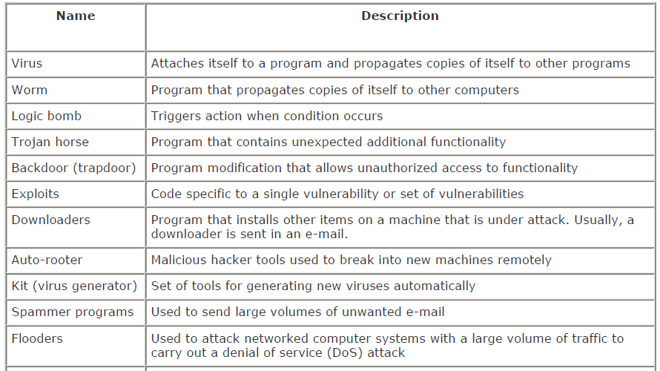
Malicious Programs
Terminology of Malicious Programs

Slide 53

Malicious Programs
Terminology of Malicious Programs

Slide 54
Virus
Nature of Virus
A virus is a piece of software that can "infect" other programs by modifying them; the modification includes a copy of the virus program, which can then go on to infect other programs.
During its lifetime, a typical virus goes through the following four phases:
Dormant phase: The virus is idle. The virus will eventually be activated by some event, such as a date, the presence of another program or file, or the capacity of the disk exceeding some limit. Not all viruses have this stage.
Propagation phase: The virus places an identical copy of itself into other programs or into certain system areas on the disk. Each infected program will now contain a clone of the virus, which will itself enter a propagation phase.
Triggering phase: The virus is activated to perform the function for which it was intended. As with the dormant phase, the triggering phase can be caused by a variety of system events, including a count of the number of times that this copy of the virus has made copies of itself.
Execution phase: The function is performed. The function may be harmless, such as a message on the screen, or damaging, such as the destruction of programs and data files.

Slide 55
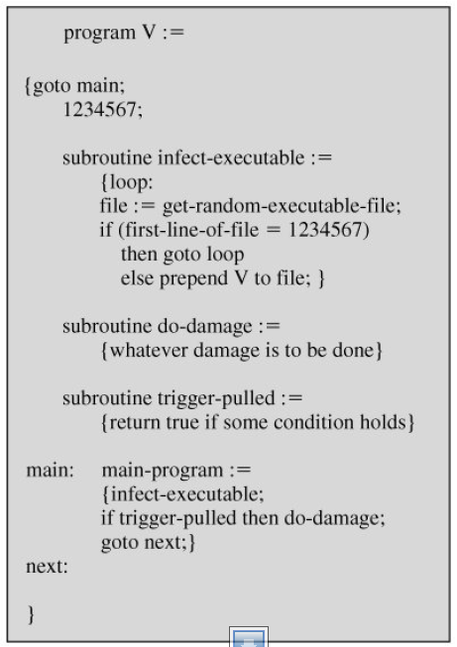
Virus
Virus Structure
A virus can be prepended or postpended to an executable program, or it can be embedded in some other fashion.

Slide 56
Types of Viruses
Parasitic virus:
A parasitic virus attaches itself to executable files and replicates, when the infected program is executed, by finding other executable files to infect.
Memory-resident virus:
Lodges in main memory as part of a resident system program. From that point on, the virus infects every program that executes.
Boot sector virus:
Infects a master boot record or boot record and spreads when a system is booted from the disk containing the virus.
Stealth virus:
A form of virus explicitly designed to hide itself from detection by antivirus software.
Polymorphic virus:
A virus that mutates with every infection, making detection by the "signature" of the virus impossible.
Metamorphic virus:
As with a polymorphic virus, a metamorphic virus mutates with every infection.

Slide 57
Firewalls
Firewalls can be an effective means of protecting a local system or network of systems from network based security threats while at the same time affording access to the outside world via wide area networks and the Internet.
Design goals for a firewall:
All traffic from inside to outside, and vice versa, must pass through the firewall. This is achieved by physically blocking all access to the local network except via the firewall
Only authorized traffic, as defined by the local security policy, will be allowed to pass.
The firewall itself is immune to penetration.

Slide 58
Characteristics of Firewall
Service control: Determines the types of Internet services that can be accessed, inbound or outbound.
Direction control: Determines the direction in which particular service requests may be initiated and allowed to flow through the firewall.
User control: Controls access to a service according to which user is attempting to access it.
Behavior control: Controls how particular services are used.

Slide 59
Types of Firewalls
Three common types of firewalls:
packet filters,
application-level gateways, and
circuit-level gateways

Slide 60
Types of Firewalls 1. Packet filters
A packet-filtering router applies a set of rules to each incoming and outgoing IP packet and then forwards or discards the packet.
Filtering rules are based on information contained in a network packet:
Source IP address: The IP address of the system that originated the IP packet
Destination IP address: The IP address of the system the IP packet is trying to reach
Source and destination transport-level address: The transport level port number, which defines applications such as SNMP or TELNET
IP protocol field: Defines the transport protocol
Interface: For a router with three or more ports, which interface of the router the packet came from or which interface of the router the packet is destined for

Slide 61
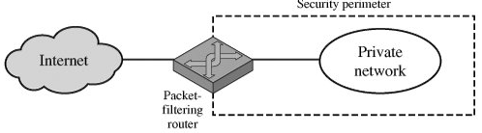
Types of Firewalls 1. Packet filters

Slide 62
Types of Firewalls 2. Application-level gateways
An application-level gateway, also called a proxy server, acts as a relay of application-level traffic
The user contacts the gateway using a TCP/IP application (TELNET/FTP) and asks the user for the name of the remote host to be accessed
When the user responds and provides a valid user ID and authentication information, the gateway contacts the application on the remote host and relays TCP segments containing the application data between the two endpoints.
If the gateway does not implement the proxy code for a specific application, the service is not supported and cannot be forwarded across the firewall.
Further, the gateway can be configured to support only specific features of an application that the network administrator considers acceptable while denying all other features.
Adv: more secure
Dis-Adv: additional processing overhead on each connection

Slide 63
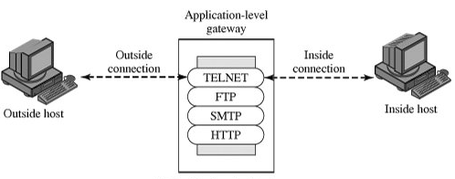
Types of Firewalls 2. Application-level gateways

Slide 64
Types of Firewalls 3. Circuit-level gateways
It is stand-alone system or it can be a specialized function performed by an application-level gateway for certain applications.
A circuit-level gateway does not permit an end-to-end TCP connection; rather, the gateway sets up two TCP connections, one between itself and a TCP user on an inner host and one between itself and a TCP user on an outside host.
Once the two connections are established, the gateway typically relays TCP segments from one connection to the other without examining the contents.
The security function consists of determining which connections will be allowed.
A typical use of circuit-level gateways is a situation in which the system administrator trusts the internal users.

Slide 65
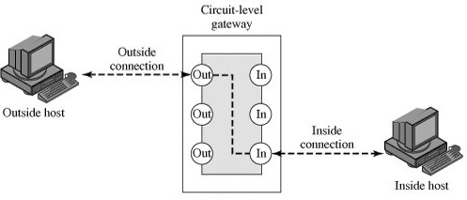
Types of Firewalls 3. Circuit-level gateways

